Slide 1

Department of Computer Science & Engineering
Internship Presentation(18CSI85)
Swizosoft
Under the Guidance of :
Mr. Mehboob Khan
Trainer
Swizosoft
Sughosha S V
4SF20CS158

Slide 2
Contents
About the Company
Internship Objectives
Internship Details
About Training
Task Assigned
Result of the Assigned Task
Internship Outcomes

Slide 3

About the Company
Establishment: Founded on October 24, 2023, in Mangalore, Karnataka.
Mission: Focused on training the next generation of tech enthusiasts by combining knowledge with practical software development skills.
Vison: Equipping individuals with the knowledge and skills to succeed in the ever-changing tech world.
Figure 1 : Company Logo

Slide 4
About the Company
Product and Service of Swizosoft :
Training : Software training teaches essential skills for using diverse applications, from basics to advanced topics, fostering confidence and proficiency through practical exercise.
Website Building : website building service offers custom solutions crafted by expert developers, tailored to meet your unique business needs.
Poster Design: Bright and lively colors fill this striking poster, capturing attention with a burst of energy and vibrancy.
Graphic Design : Graphic design is a creative discipline melding visual elements to convey messages

Slide 5
Internship Objectives
Gain hands-on experience in full stack development.
Enhance technical skills through real-world projects.
To learn advanced techniques associated to related field.
Gain insight into the software development lifecycle and industry standards.

Slide 6
Internship Details
Start date – 12 /02/2024
End date – 12/03/2024
Total duration – 1 month
Position – Intern
Lead (mentor name) – Mr. Mahboob Khan
Office hours – 10am – 9 pm
Office days – Mon – Sat
Team size – 1
Role in the Team – Full stack web developer intern

Slide 7
Training Given
HTML(Hyper Text Mark Up Language): Learned the concept of HTML elements, which form the foundation of web pages. Gained knowledge on using tags to structure content, including headings, paragraphs, images, and links. Became familiar with the structure of HTML documents using tags like <html>, <head>, and <body>.
CSS(Cascading Style Sheets): Explored CSS as the tool for styling HTML elements. Covered selectors, properties, and values to control the appearance of elements, including aspects like colors, fonts, and layout.
JavaScript : Acquainted with JavaScript's basic syntax, data types, and control structures like loops and conditionals. Learned to utilize JavaScript for interactive elements on web pages, such as managing user clicks and inputs, and responding to events. Also introduced to JavaScript's functions, arrays, and objects.
Static web pages : Utilizing knowledge of HTML, CSS, and JavaScript, static web pages were successfully created. These pages provide consistent content to all users, remaining unchanged based on user interactions or external data.

Slide 8
Training Given
We were introduced to the MERN stack, a popular technology stack for building dynamic web applications. MERN stands for Mongo-DB, Express.js, React, and Node.js, representing the four main technologies that make up this full-stack development framework.
MongoDB is a NoSQL database that stores data in flexible, JSON-like documents, making it easy to integrate with JavaScript applications.
Express.js is a web application framework for Node.js, providing a set of robust features for building web servers and APIs quickly and efficiently.
React is a JavaScript library for building user interfaces. It allows developers to create reusable UI components and manage application state effectively.
Node.js is a runtime environment that allows JavaScript to run server-side, enabling the use of JavaScript for both client-side and server-side development.

Slide 9
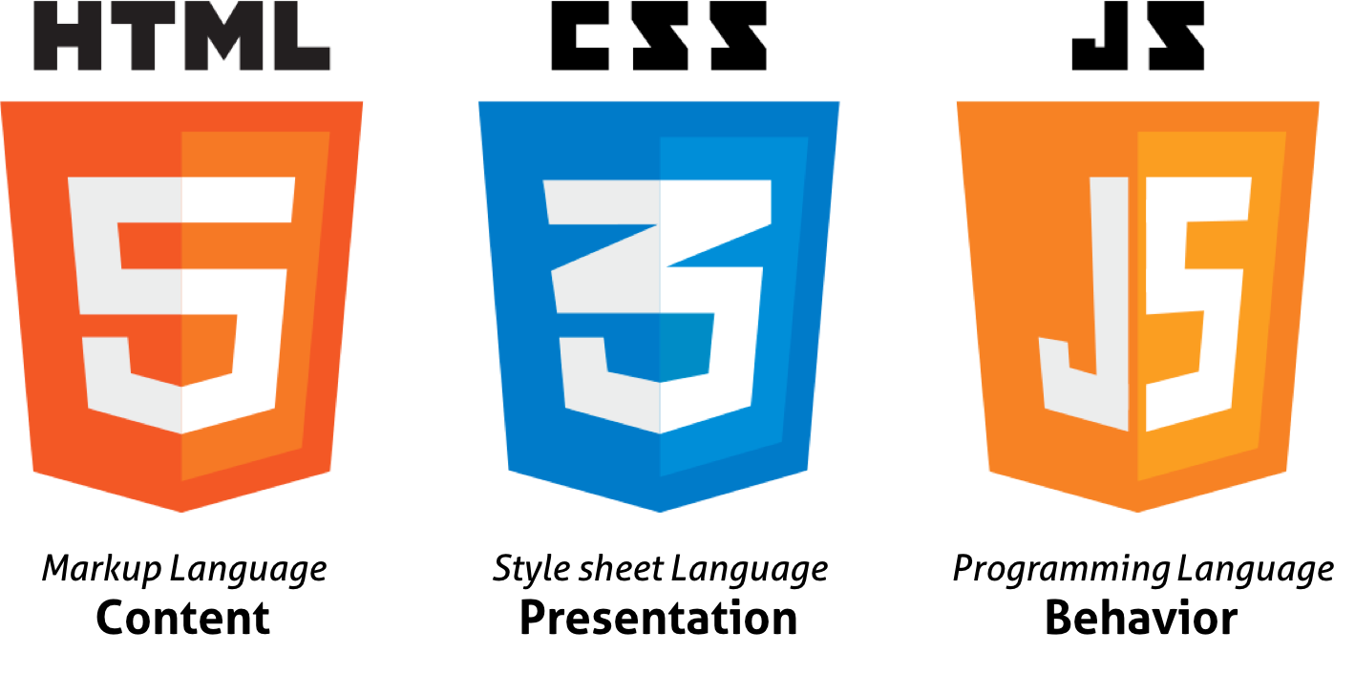
Task Assigned
First Week :
HTML Structure: I began by establishing the fundamental framework for the website using HTML, outlining the layout and various sections.
CSS Styling: With CSS, I added visual styles and design elements to the website. This included setting colors, fonts, and layout properties to improve the user experience.
JavaScript for Interactivity: To add interactivity, I incorporated JavaScript, allowing users to perform actions like clicking buttons to trigger specific behaviors.
Figure 2 : HTML, CSS ,JS

Slide 10
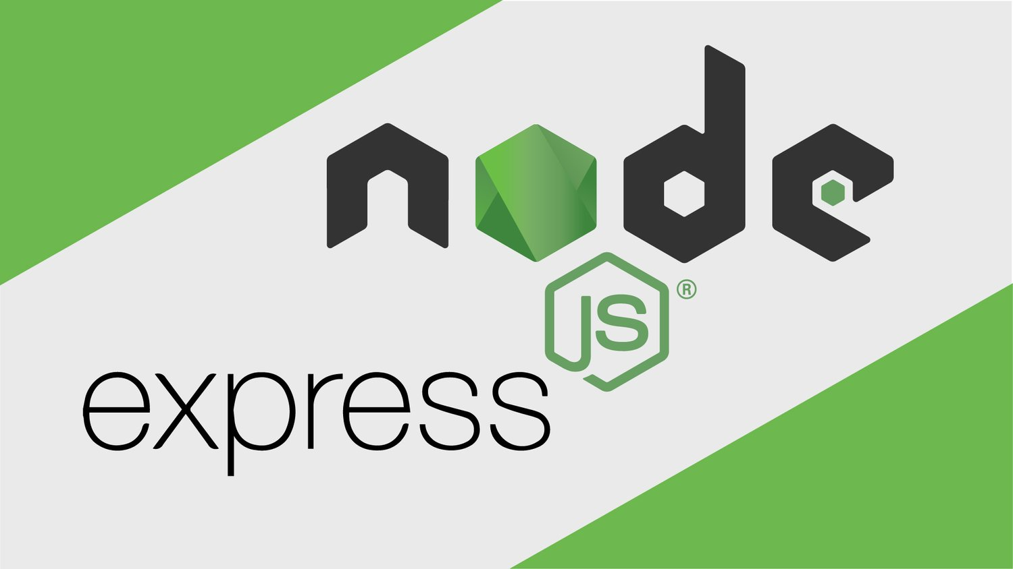
Task Assigned
Second Week :
Node.js: I began exploring Node.js, which allows JavaScript to be used on the server side.
Express.js: I worked with Express.js, a framework that simplifies building web applications and APIs. This experience introduced me to key concepts like routes, middleware, and different HTTP methods such as GET, POST, PUT, and DELETE, offering a structured approach to server-side development. HTTP methods define how we interact with the server: GET retrieves data, POST sends new data, PUT updates existing data, and DELETE removes data.
Figure 3 : Node js, Express js

Slide 11

Task Assigned
Third Week :
MongoDB: I explored MongoDB, a popular NoSQL database known for its flexibility in storing JSON-like documents, making it ideal for handling unstructured or semi-structured data.
Database Management: I learned to use mongoDB for data storage and retrieval, focusing on how to integrate it with server-side code to maintain a consistent and efficient database. This involved creating structured data models and practicing CRUD (Create, Read, Update, Delete) operations, allowing me to store and manipulate information for the website.
Figure 4 : MongoDB

Slide 12
Task Assigned
Fourth Week :
I started working on my project “Realtor” using React and Tailwindcss.
The Realtor website is a platform for browsing and managing real estate listings. It allows users to view property details, create accounts, and interact with listings, providing a comprehensive solution for those looking to buy or rent properties.
Key features :
User Authentication
Property Listings
Property Management
Responsive Design

Slide 13
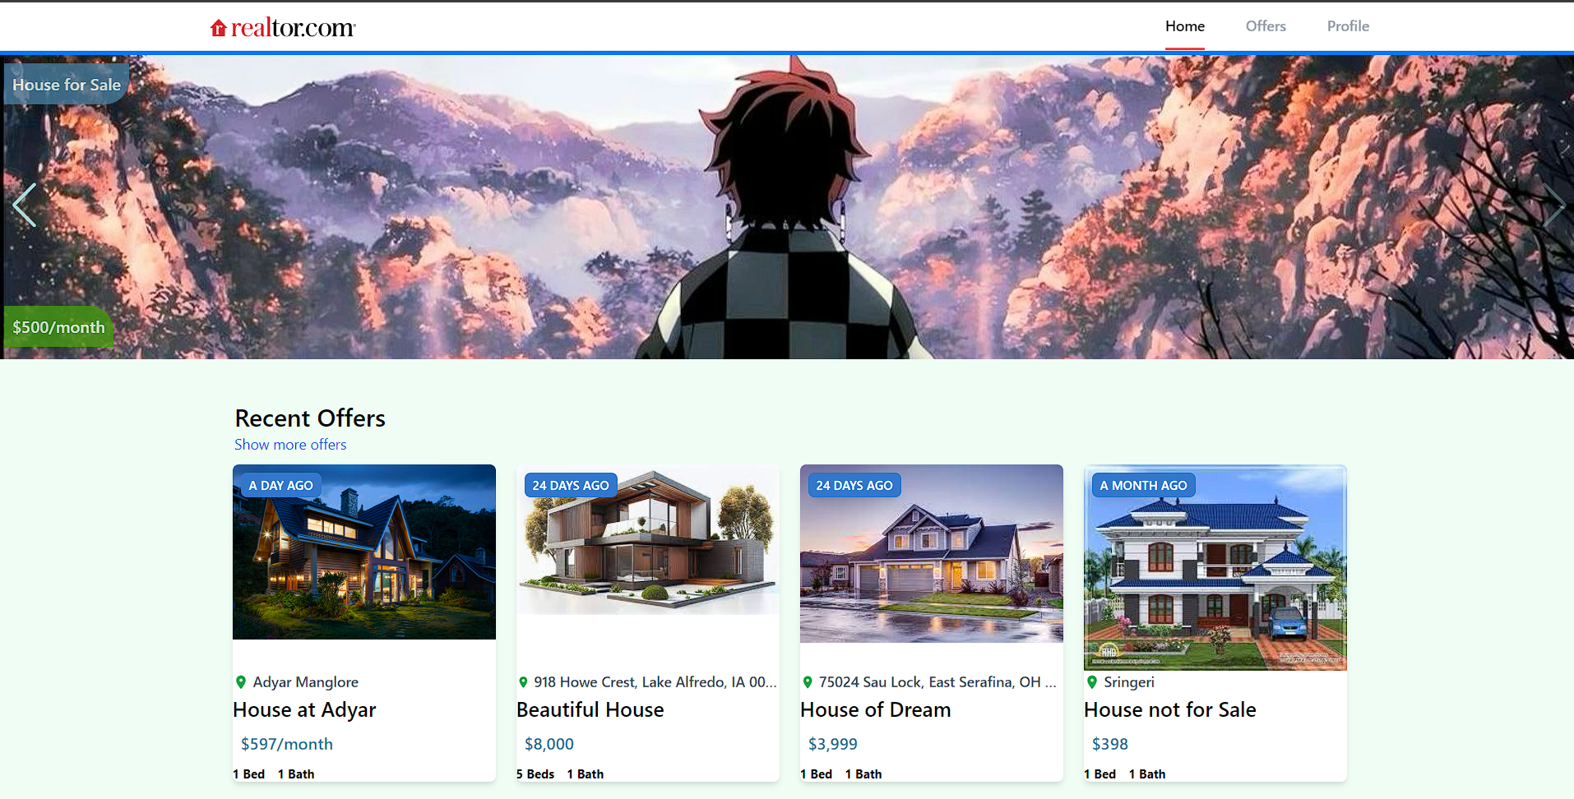
Result of the Assigned Task
Figure 5 : Home Page of Realtor

Slide 14
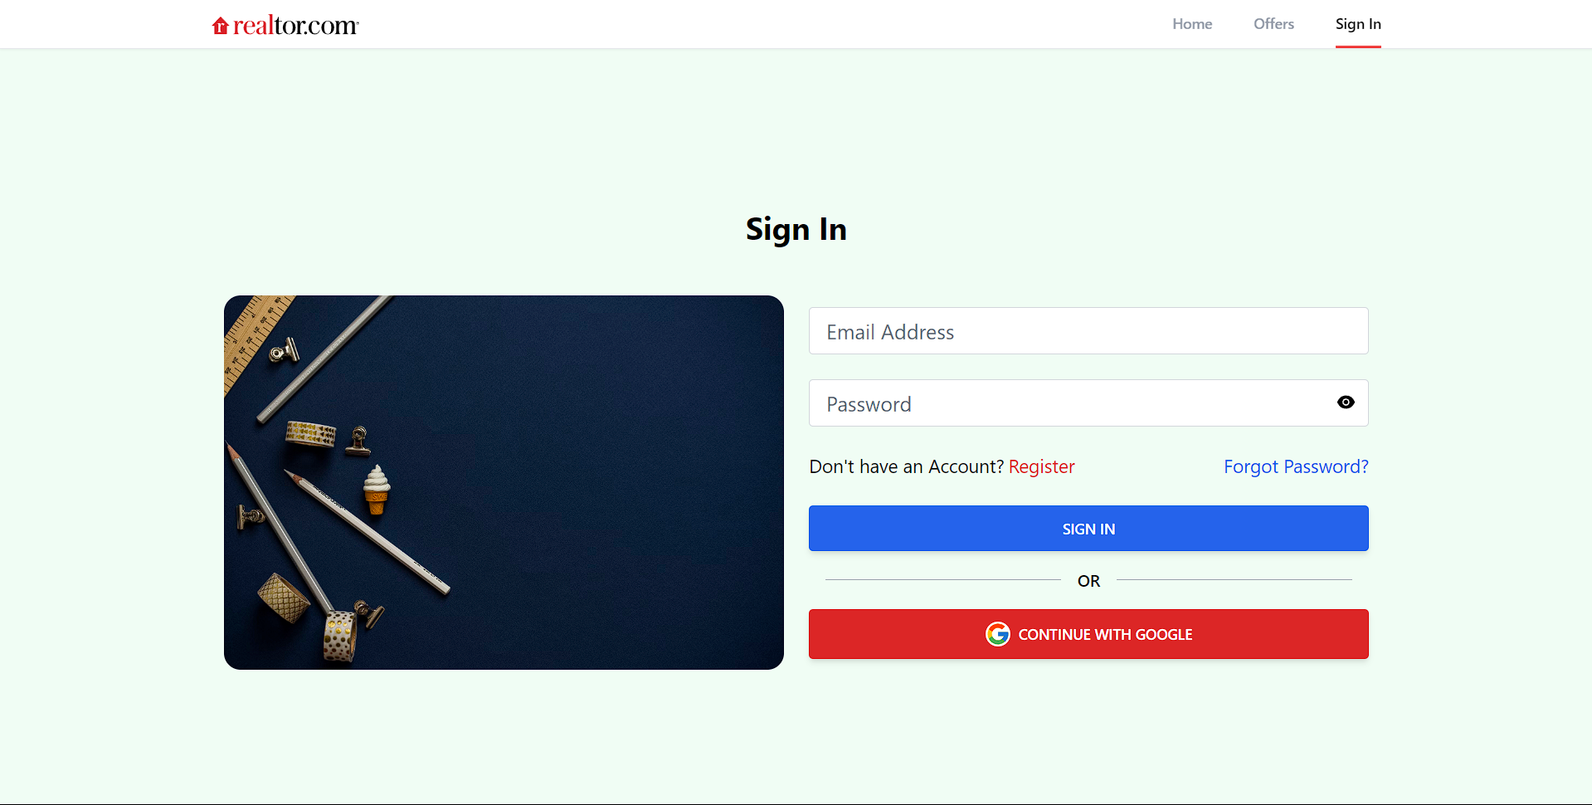
Result of the Assigned Task
Figure 6 : Login Page of Realtor

Slide 15
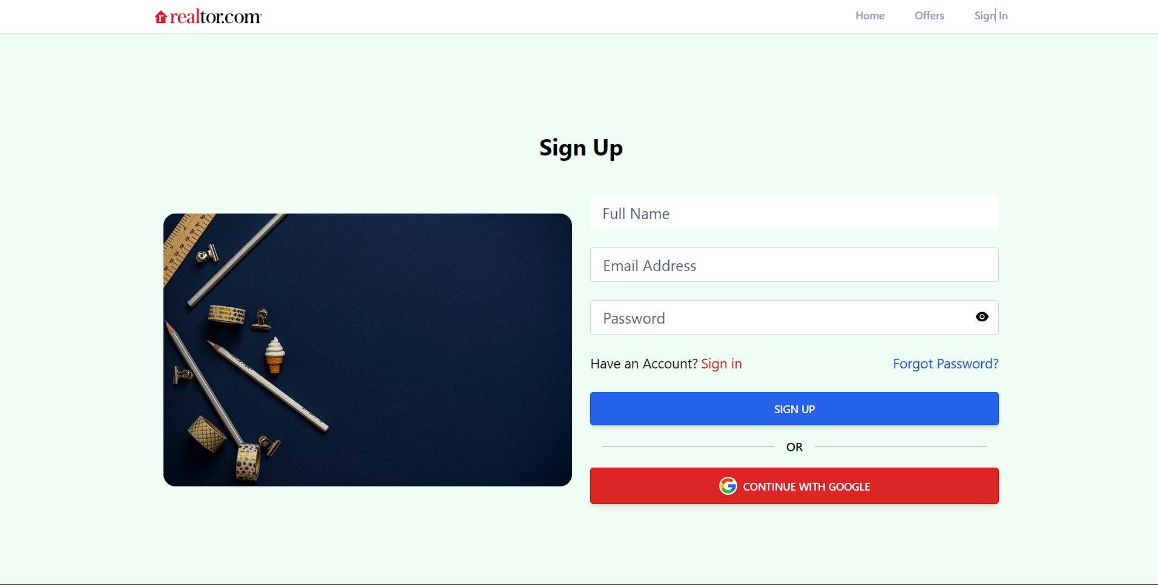
Result of the Assigned Task
Figure 7 : Signup Page of Realtor

Slide 16
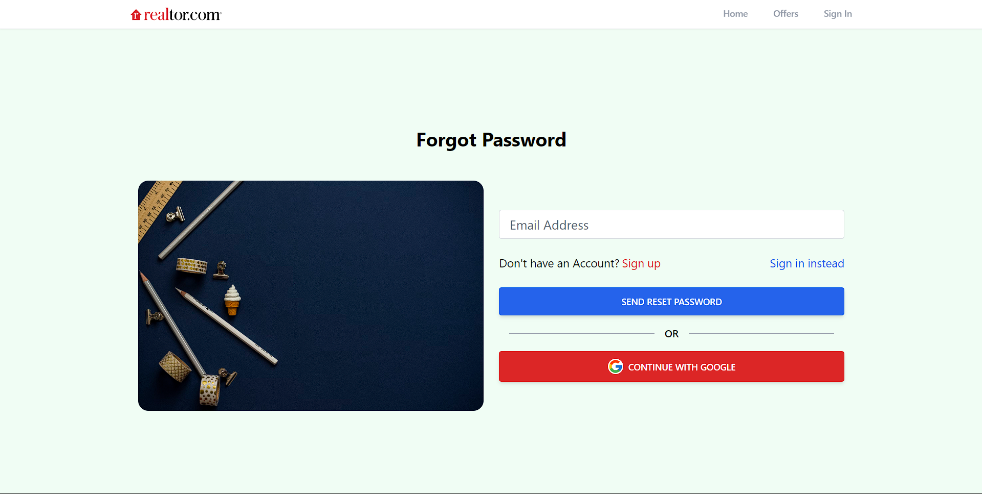
Result of the Assigned Task
Figure 8 : Reset password of Realtor

Slide 17
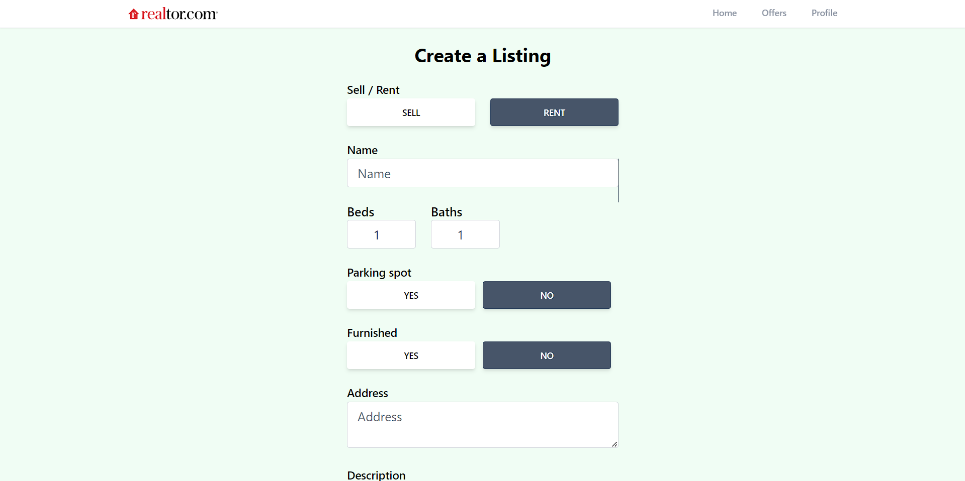
Result of the Assigned Task
Figure 9 : Create listing Page of Realtor

Slide 18
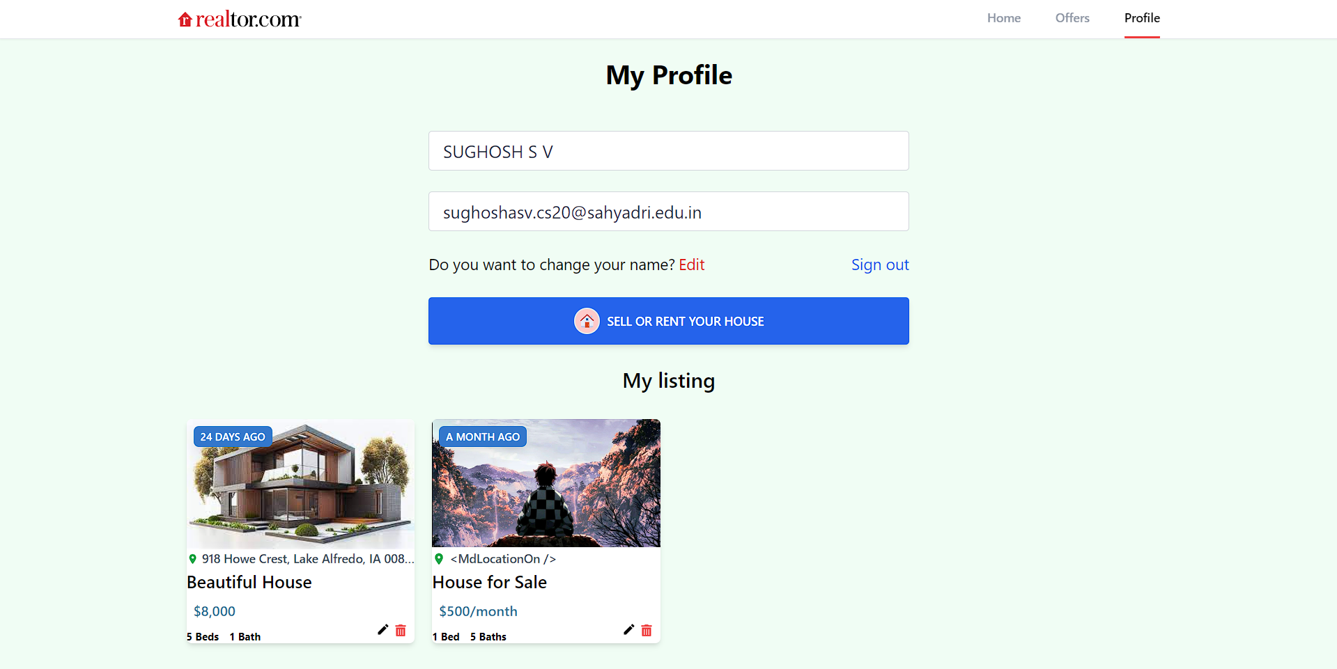
Result of the Assigned Task
Figure 10 : Users Profile Page of Realtor

Slide 19
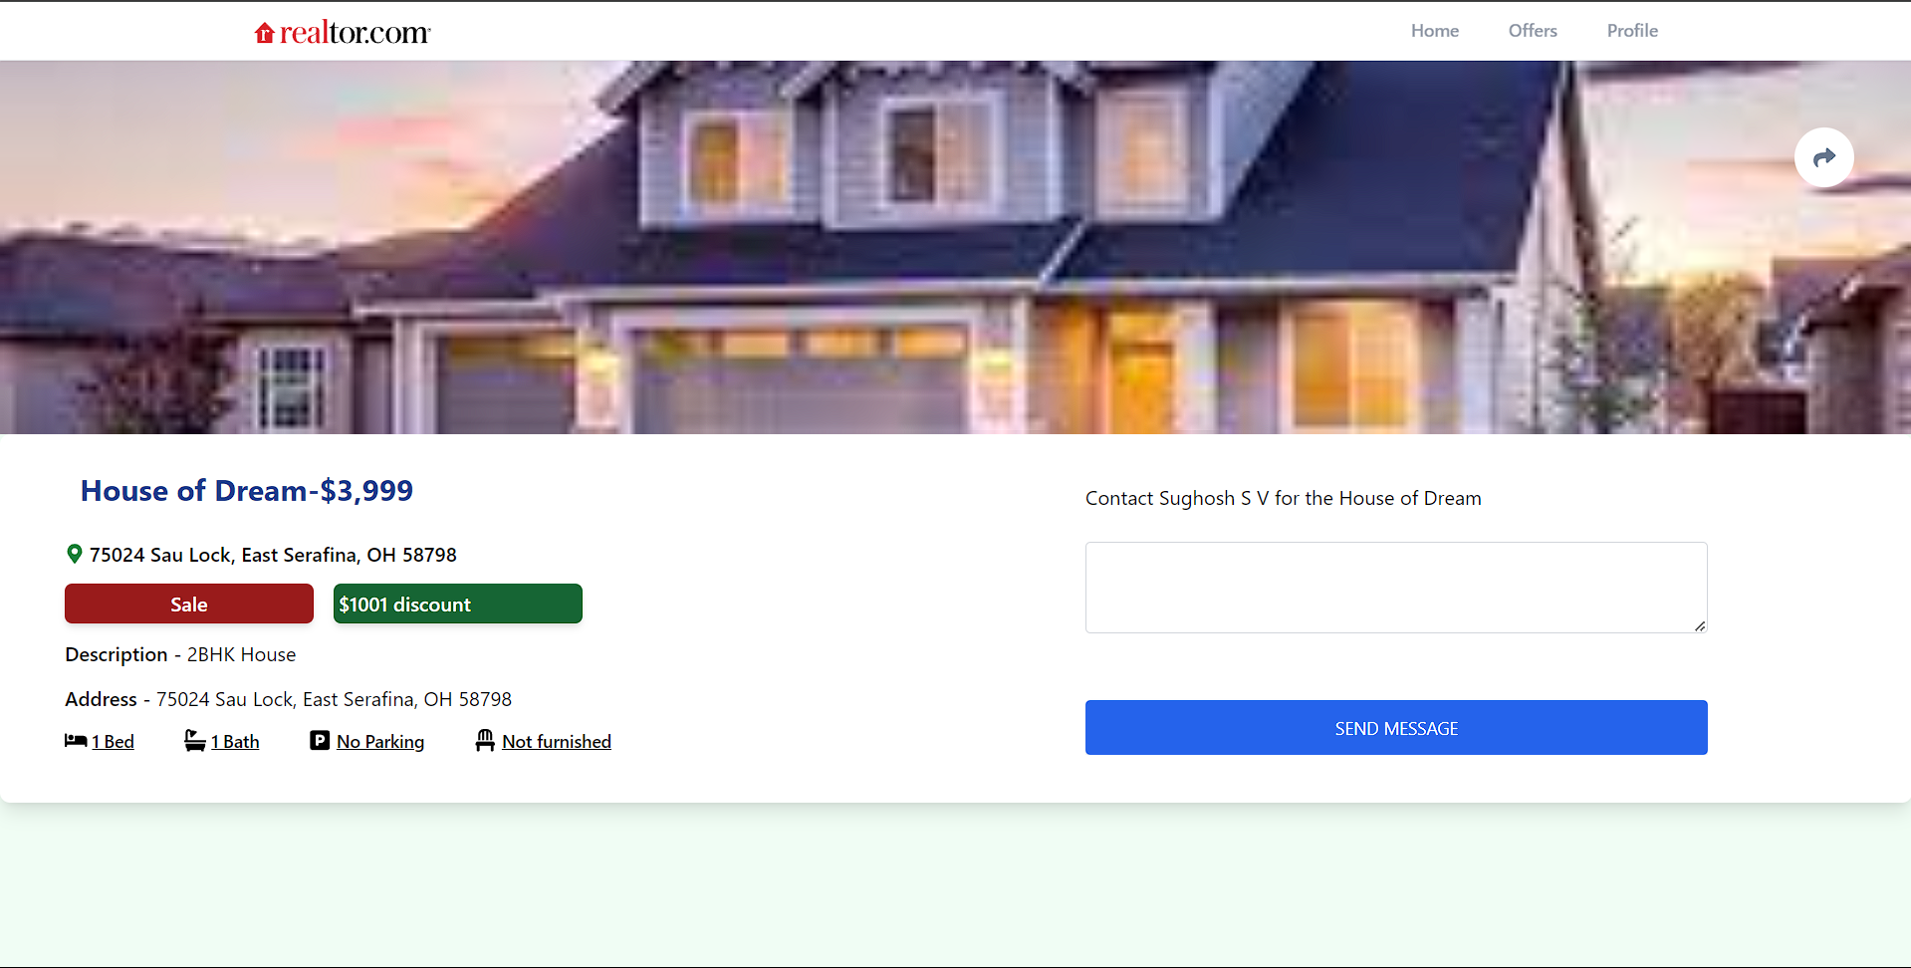
Result of the Assigned Task
Figure 11 : House details Page of Realtor

Slide 20
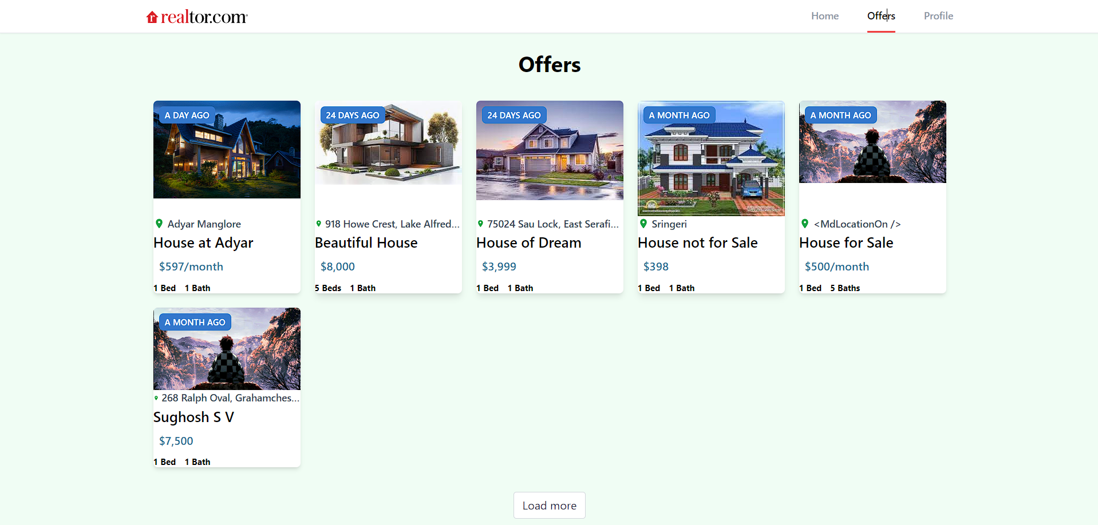
Result of the Assigned Task
Figure 12 : Offers Page of Realtor

Slide 21
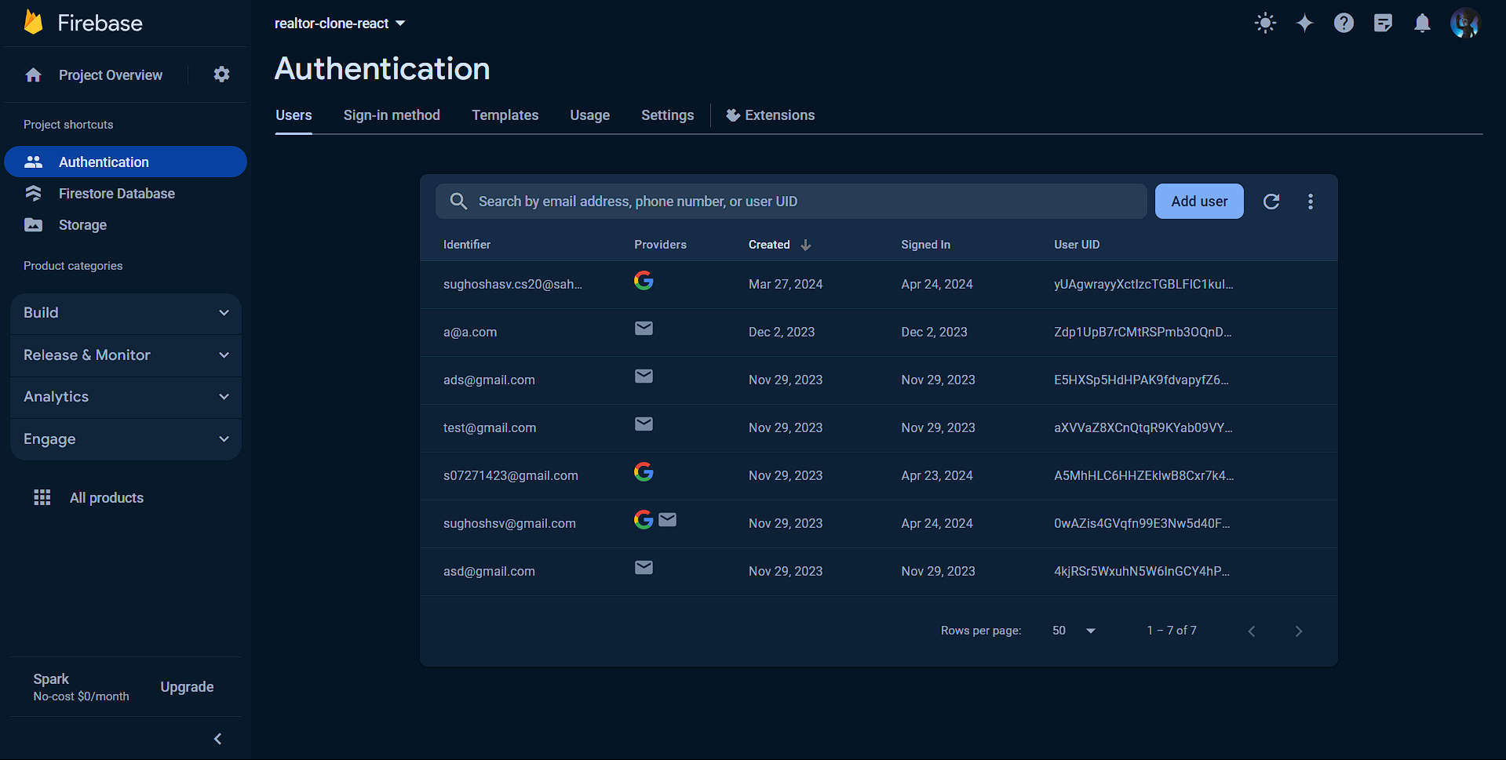
Result of the Assigned Task
Figure 13 : Database of Realtor

Slide 22
Internship Outcomes
Technical Skill Development: Through this project, During the internship, I gained in-depth knowledge of full stack web development. This included learning key technologies such as HTML, CSS, JavaScript, React, Node.js, Express, and Firebase.
Hands-On Project Experience : The internship provided opportunities to work on real-world projects. I built a Realtor website clone, which involved frontend and backend development, user authentication, and database management.
Database Management with Firebase: Working with firebase provided me with insights into NoSQL databases, learning how to efficiently store, retrieve, and manage data in a flexible schema-less environment.
Responsive Design and User Experience: Ensuring the application was accessible and user-friendly across devices taught me the importance of responsive design and user experience optimization.

Slide 23
☺ Thank You ☺

